Slide 1
Financial Instruments
Chapter 5

Slide 2
Short Selling (Pages 100-102)
Short selling involves selling securities you do not own
Your broker borrows the securities from another client and sells them in the market in the usual way
At some stage you must buy the securities back so they can be replaced in the account of the client

Slide 3
Short Selling (continued)
You must pay dividends and other benefits the owner of the securities receives
The cash flows from a short position that is entered into at time T₁ and closed out at time T₂ are the opposite of those from a long position where asset is bought at time T₁ and sold at time T₂, except that there may be a small fee for borrowing the asset

Slide 4
Derivatives
Forwards
Futures
Swaps
Options
Exotics

Slide 5
Derivatives Markets (Figure 5.1)

Slide 6
Forward Contracts
A forward contract is an agreement to buy or sell an asset at a certain price at a certain future time
Forward contracts trade in the over-the-counter market
They are particularly popular on currencies and interest rates

Slide 7
Foreign Exchange Quotes for GBP (See Table 5.2)
 | Bid | Offer
Spot | 1.2732 | 1.2736
1-month forward | 1.2746 | 1.2751
3-month forward | 1.2772 | 1.2777
1-year forward | 1.2883 | 1.2889

Slide 8
Profit from a Long Forward Position
Profit
Price of Underlying
at Maturity
K
Notes:
14

Slide 9
Profit from a Short Forward Position
Profit
Price of Underlying
at Maturity
K
Notes:
15

Slide 10
Futures Contracts (page 104-108)
Agreement to buy or sell an asset for a certain price at a certain time
Similar to forward contract
Whereas a forward contract is traded over the counter (OTC), a futures contract is traded on an exchange

Slide 11
Futures Contract continued
Contracts are settled daily (e.g., if a contract is on 200 ounces of December gold and the December futures price moves $2 in my favor, I receive $400; if it moves $2 against me I pay $400)
Both sides to a futures contract are required to post margin with the exchange clearinghouse. This ensures that they will honor their commitments under the contract.

Slide 12
LIBOR Phase Out
LIBOR used to be a very important reference rate
It is being phased out and replaced by overnight rates (e.g., SOFR in the U.S.)

Slide 13
The New Reference Rates
Overnight rates can be compounded daily to produce rates applicable to longer periods (e.g. 3 months) but the rate is not known until the end of the period
The overnight rates are regarded as risk-free rates

Slide 14
Swaps
A swap is an agreement to exchange cash flows at specified future times according to certain specified rules

Slide 15
An Example of a “Plain Vanilla” Interest Rate Swap
An agreement to receive 6-month SOFR & pay a fixed rate of 3% per annum every 6 months for 3 years on a notional principal of $100 million
Next slide illustrates cash flows

Slide 16
Cash Flows for one set of SOFR rates
(See Table 5.4, page 110)
Date | Floating Cash Flow Received | Fixed Cash Flow Paid | Net Cash Flow
Mar. 3, 2024
Sep 3, 2024 | +1.10 | −1.50 | −0.40
Mar 3, 2025 | +1.40 | −1.50 | −0.10
Sep 3, 2025 | +1.65 | −1.50 | +0.15
Mar 3, 2026 | +1.75 | −1.50 | +0.25
Sep 3, 2026 | +1.80 | −1.50 | +0.30
Mar 3, 2027 | +1.95 | −1.50 | +0.45

Slide 17
Typical Uses of an
Interest Rate Swap
Converting a liability from
  fixed rate to floating rate
  floating rate to fixed rate
Converting an investment from
  fixed rate to floating rate
  floating rate to fixed rate

Slide 18
Quotes By a Swap Market Maker (Table 5.5, page 112)
Maturity | Bid (%) | Offer (%) | Swap Rate (%)
2 years | 2.55 | 2.58 | 2.565
3 years | 2.97 | 3.00 | 2.985
4 years | 3.15 | 3.19 | 3.170
5 years | 3.26 | 3.30 | 3.280
7 years | 3.40 | 3.44 | 3.420
10 years | 3.48 | 3.52 | 3.500

Slide 19
Options
A call option is an option to buy a certain asset by a certain date for a certain price (the strike price)
A put option is an option to sell a certain asset by a certain date for a certain price (the strike price)
Options trade on both exchanges and in the OTC market

Slide 20
American vs European Options
An American option can be exercised at any time during its life
A European option can be exercised only at maturity

Slide 21
Intel Option Prices: Jan 24, 2022; Stock Price=51.98 (See Table 5.6; page 113)
Strike Price | Mar 22 Call | May 22 Call | Jul 22 Call | Mar 22 Put | May 22 Put | Jul 22 Put
45 | 7.77 | 8.47 | 8.87 | 1.03 | 1.96 | 2.35
47.5 | 5.77 | 6.67 | 7.17 | 1.55 | 2.64 | 3.15
50 | 4.05 | 5.10 | 5.65 | 2.32 | 3.60 | 4.15
52.5 | 2.64 | 3.77 | 4.37 | 3.42 | 4.77 | 5.35
55 | 1.61 | 2.73 | 3.30 | 4.90 | 6.25 | 6.80
57.5 | 0.93 | 1.92 | 2.48 | 6.72 | 7.90 | 8.47

Slide 22
Options vs Futures/Forwards
A futures/forward contract gives the holder the obligation to buy or sell at a certain price
An option gives the holder the right to buy or sell at a certain price

Slide 23
Hedging Examples
A US company will pay £10 million for imports from Britain in 3 months and decides to hedge using a long position in a forward contract
An investor owns 1,000 shares currently worth $28 per share. A two-month put with a strike price of $27.50 costs $1. The investor decides to hedge by buying 10 contracts
Notes:
16

Slide 24
Options vs Forwards
Forward contracts lock in a price for a future transaction
Options provide insurance. They limit the downside risk while not giving up the upside potential. But they require an upfront payment.

Slide 25
Interest Rate Options
Caps and floors
Swap options
Bond options

Slide 26
Nontraditional Derivatives (pages 115-119)
Weather derivatives
Energy derivatives
  Oil
  Natural gas
  Electricity

Slide 27
Exotic Options (pages 119-120)
Asian options
Barrier option
Basket options
Binary options
Compound options
Lookback options

Slide 28
Example of the Use of Exotic Options (Business Snapshot 5.3)
If a company earns revenue month by month in many different currencies, Asian basket put options can provide an appropriate hedge

Slide 29
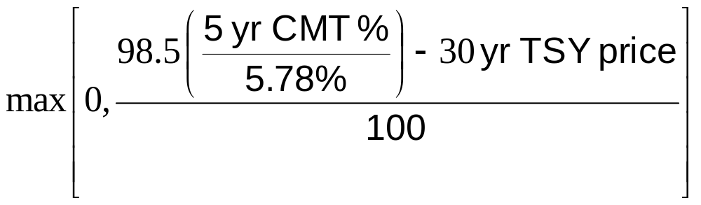
Structured Products
Products created to meet the needs of clients
A bizarre structures product is the “10/30” deal between Bankers Trust and Procter and Gamble (See Business Snapshot 5.4)
The payments by P&G were

Slide 30
Types of Traders
Hedgers
Speculators
Arbitrageurs
Some of the largest trading losses in derivatives have occurred because individuals who had a mandate to be hedgers or arbitrageurs switched to being speculators (See for example SocGen, Business Snapshot 5.5.)

